Slide 1
PREDICTING THE PROBABILITY OF SEVERE ACCIDENTS BASED ON WEATHER CONDITIONS
By Andi Frkovich
September 10, 2020

Slide 2
Part I: Introduction
Seattle Police Department (SPD) is responsible for responding to and clearing traffic accidents throughout the Seattle and also responding to a variety of other local crises and incidents. Predicted weather conditions on different days and seasons may help police predict the probability of severe traffic accidents throughout the city. Police could then use this information to optimize assigned shifts and manpower allocation between different SPD units.
Data that would help us understand the impact of weather on traffic accident severity includes meteorological weather, road conditions, and light conditions.
Others who may be interested in the data include:
local hospitals, which can use the information to optimize staffing and equipment availability
local news and public health organizations, which could leverage the information to issue timely health warnings to the public.

Slide 3
Part II: Data Acquisition & cleaning
Data pulled from Kaggle dataset located ​here​.
Data problems and solutions
Problem: various attributes were over-weighted to certain outcomes
Solution: decrease the weighting of those particular outcomes and normalize the dataset
Problem: Data is descriptive, vice numeric
Solution: converted descriptive data (i.e., ‘dry road’) to numeric data where the number assigned corresponds to the severity of conditions
Problem: features missing data
Solution: features missing data were dropped. 194,310 attributes remained, a very robust n sample.
No significant outliers found
Problem: various attributes were over-weighted to certain outcomes
Target variable: Severity Code
Features Selection
numerous features that feed into the ‘severity code’ attribute were not kept, as they are already reflected in the resultant ‘severity code’.
The data contained numerous administrative attributes, which would solely be used to help police keep administrative track of the data. Because these attributes are arbitrary administrative descriptors, these attributes were also dropped.
Final set: 194,310 features and four attributes.

Slide 4
Part III: data exploration
Initial exploration of the data revealed significant relationships between weather conditions and accident severity.
Weather: strong crosswinds were by far the greatest predictor of the most severe accidents, with 78% of category 3 accidents occurring during periods of strong headwinds (after re-weighting data due to oversampling of clear conditions)
Road conditions: Poor road conditions seemed to cause more accidents, but didn’t result in the most severe accidents, probably due to slower speeds and increased driver caution. Interestingly, the most accidents occurred in dry road conditions.
Light conditions: After re-weighting the data, we can see that the vast majority of the most severe accidents (category 3) occur in reduced light conditions.

Slide 5
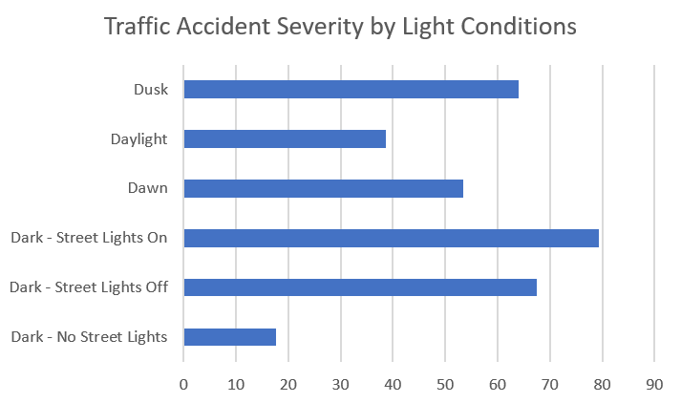
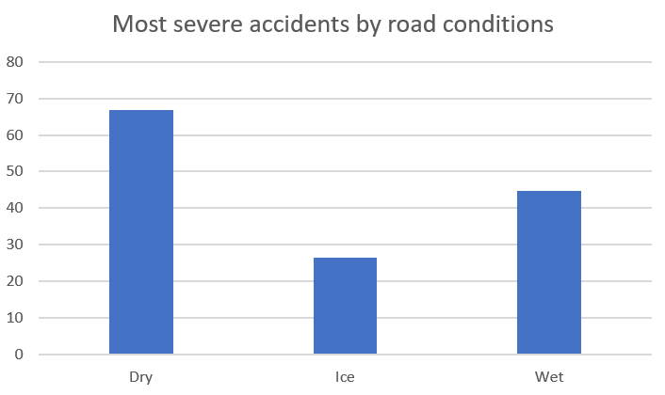
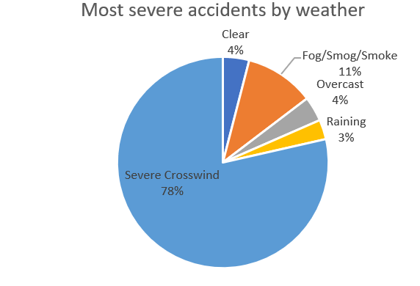
Part III: data exploration cont.

Slide 6
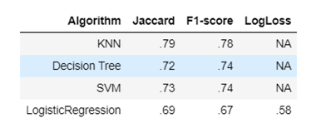
Part iv: methodology & predictive modelling
Because this particular study aims to predict the probability of engaging in a severe (‘Category 3) accident, we focus primarily on classification models. We apply the K-Nearest Neighbor, Decision tree, Logistic Regression, and SVM models.
all categorical values of data had to be converted to numeric values and numerous attributes had to be re-weighted to account for overrepresentation
The Jaccard and F-1 Scores were used as the primary evaluation metrics.
To apply the classification models, I divided the data into two classes (Severity Code>=0 or <3
KNN, with K=8, proved to be the most accurate model, although the accuracy of the models was relatively comparable.

Slide 7
Part V: Conclusions
In this project, I evaluated the relationship between weather conditions and severe car accidents. I identified severity code as the target variable and weather, road conditions, and light conditions as the independent variable. Because this study is primarily concerned with the probability of a severe accident, I applied a variety of classification models to predict such probability. Findings reveal that driving certain severe weather conditions, i.e., strong winds and low-light conditions, likely increases the probability of being involved in a severe car accident. These models will aid Seattle Police Department and surrounding hospitals with predictive resource allocation.

Slide 8
Part VI: Future directions
In this project, I was able to achieve ~78% accuracy in classification. However, significant variance still remains. The models could be improved with more granular (and more accurately scaled) weather data.
For example, instead of collecting descriptive data for road conditions, data on the relative slipperiness of roads could be a more accurate indicator.
More reliably scaled information on light conditions would also help improve the accuracy of the models (for example, is a street without streetlight or a street with its streetlights off darker?).
More data, specifically on how weather impacts road and light conditions, would be helpful.
For local hospitals, it could also be helpful to know if certain weather conditions are more heavily linked to specific injury severity or types.

